Slide 1
marseille March 2017
WP2 Archana Singh-Manoux
AURORE FAYOSSE

Slide 2
How do socioeconomic factors affect health at older ages
Objectives (WP2)
Examine evidence for social inequalities in
Cardiovascular disease
Diabetes
Cancer
Chronic lung disease
Musculoskeletal disorders
Depression
Neurologic disorders
Multi-morbidity
Conclusions
Research focus did not take dynamic lifecourse view
Little research on multimorbidity

Slide 3
Project 1

Slide 4
Socioeconomic factors: cognitive function, cognitive decline & dementia
CONTEXT
Socioeconomic DEMENTIA
factors
(Education)
Buffer hypothesis
Active process (slower cognitive decline, less neudegeneration, etc.)
Jennifer Rusmaully
Aline Dugravot
Jean-Paul Moatti
Michael G Marmot
Alexis Elbaz
Mika Kivimaki
Séverine Sabia
Archana Singh-Manoux

Slide 5
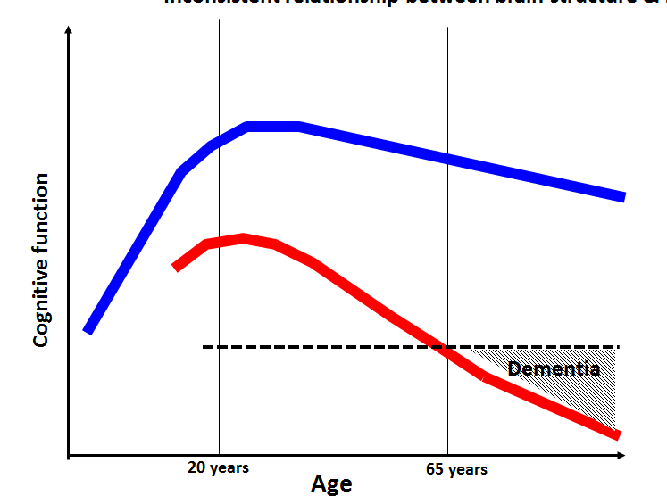
Cognitive function, cognitive decline & dementia
Role of socioeconomic factors
Height
Education
Occupation
cognitive performance
cognitive decline
dementia

Slide 6
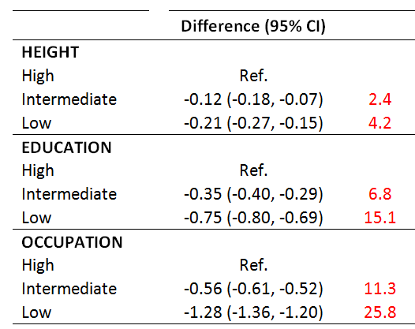
Socioeconomic Factors & Cognitive performance

Slide 7
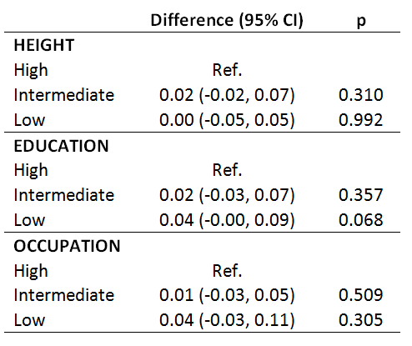
Socioeconomic Factors & Cognitive DECLINE (15 years)

Slide 8
Socioeconomic factors & dementia

Slide 9
Socioeconomic factors & dementia

Slide 10
Socioeconomic factors & dementia

Slide 11
Cognitive decline in those with dementia

Slide 12
Conclusions: SES & dementia
Brain training?
PUBLIC HEALTH POLCY HERE

Slide 13
Project 2

Slide 14
Socioeconomic factors & Multi-morbidity
CONTEXT
Multimorbidity is the occurrence of multiple diseases in the same person; comorbidity
Over 60% of older adults are multimorbid
Social inequalities in multimorbidity; some evidence that inequalities weaker at older ages
BUT most of the evidence is cross-sectional…
RESEARCH QUESTION
How do socioeconomic factors affect transitions from one chronic disese to multimorbidity to death?
Education or SES?

Slide 15
Multi-morbidity
Our definitions
Cardiometabolic multimorbidity
2/7 common chronic diseases

Slide 16
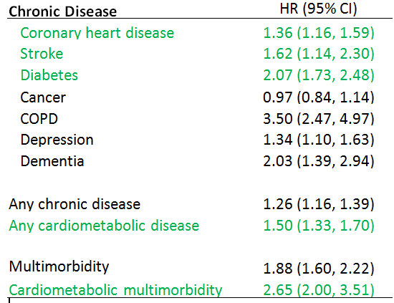
Association of occupation with chronic diseases and multimorbidity

Slide 17
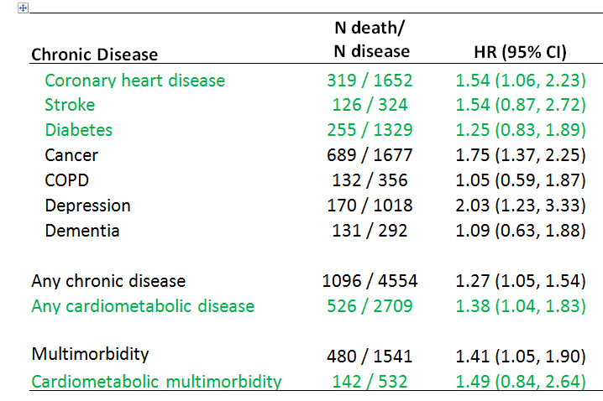
Association of chronic diseases & multimorbidity with mortality

Slide 18
Socioeconomic factors & transitions: multimorbidity
SES
1st Chronic disease
Multimorbidity
Death
Disability

Slide 19
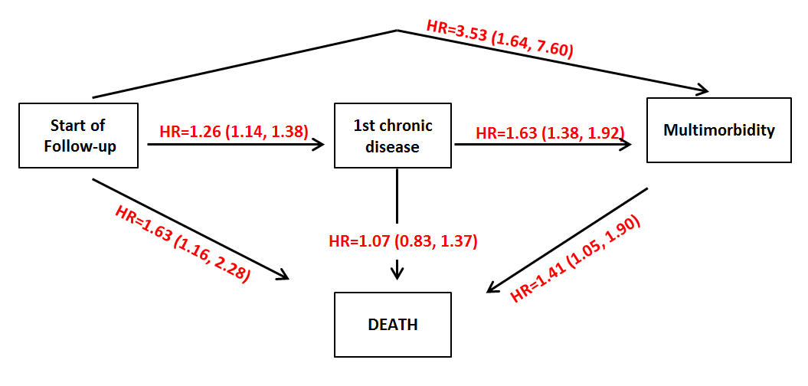
Socioeconomic factors & transitions: multimorbidity

Slide 20
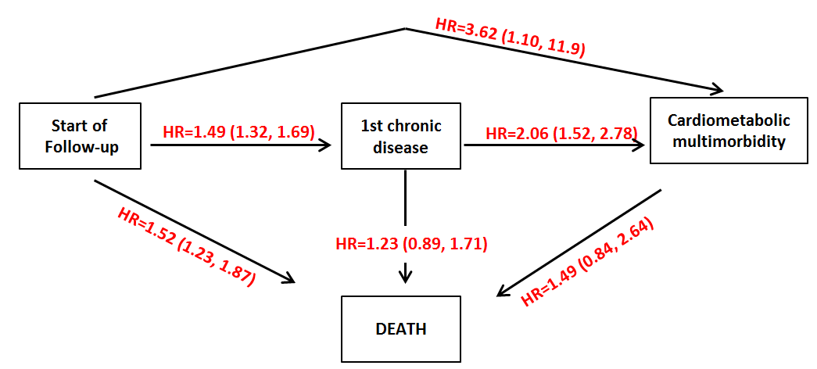
Socioeconomic factors & transitions: cardiometabolic multimorbidity

Slide 21
NEXT STEPS
Assess role of common risk factors: health behaviours
Assess whether multimorbidity transitions vary as a function of 1st chronic disease
Look at these associations in a larger dataset…

